Slide 1
Overbooking Model
Bumped
If ready to board > capacity
Actual demand
Ready to board
Booked passengers
Flying
Overbooking limit
MIN
Booking capacity
No shows
+
Capacity

Slide 2

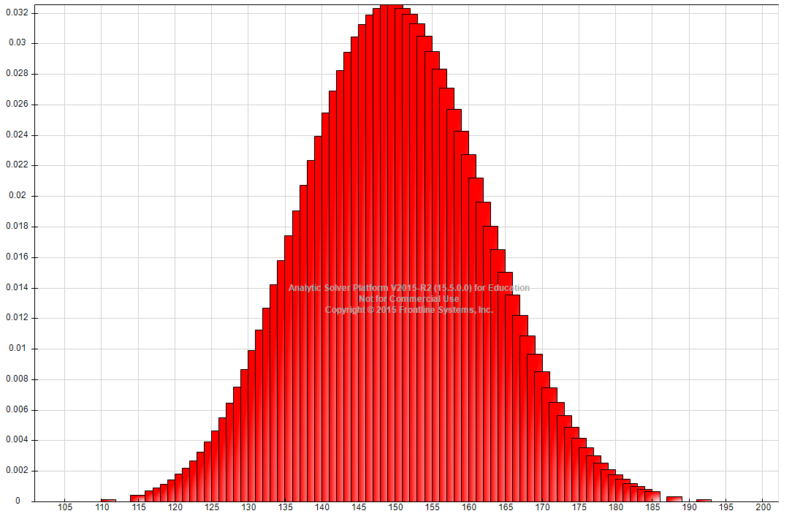
Distribution of Passenger Demand

Slide 3
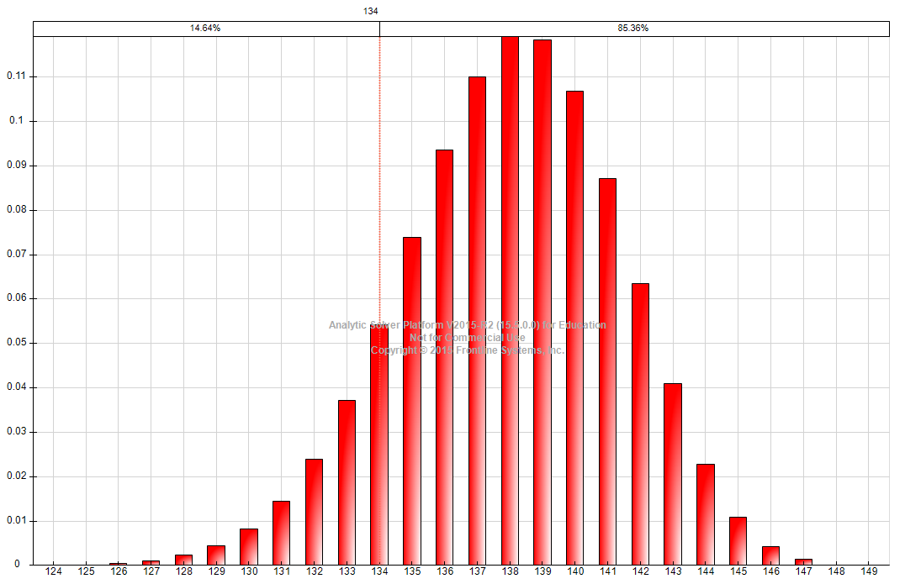
Binomial Distribution for 150 Passengers

